Slide 1
AOSC201: Class Overview and Lab 2: Atmospheric Basics
TA: Hannah Daley

Slide 2
General Lab Structure
Students will enter the classroom, open the class website, and begin reading the introduction paragraph for the lab assigned for that week.
-Class Website (cap sensitive): https://www.atmos.umd.edu/~hmdaley/AOSC201/
-Personal laptops or phones are not permitted during class
-Labs will not be assigned in sequential order
-Each class will start with an instruction overview and then students may begin completing their lab INDIVIDUALLY unless otherwise instructed

Slide 3
Lab Manual
Weather and Climate Laboratory Manual 1st Edition
by Canty and Sluka
ISBN: 978-1-4652-5717-8
The lab manual includes informative paragraphs that often contain the answers needed on to answer the conceptual lab questions.
You must bring the lab manual to every class! Failing to come prepared to lab will result in a zero for the lab assignment.
I have a few spares to give this lab for those who have not purchased their lab notebook.

Slide 4
Attendance/ Drop Lab Policy
-Your grade consists of 12 labs ( No final)
-The lowest scored lab will be dropped (not included in your averaged grade)
-Your first missed lab (excused or unexcused) will be your drop lab and you will not be permitted to make up the lab.
-Your second missed lab may only be made up if excused (see syllabus). You must notify of excuse (email) before lab or sickness within 24 hours after the lab. You must make up the lab within one week of the original lab assignment.
-Arriving late to class (10+ minutes) is considered an absence and you will be asked to leave the lab.

Slide 5
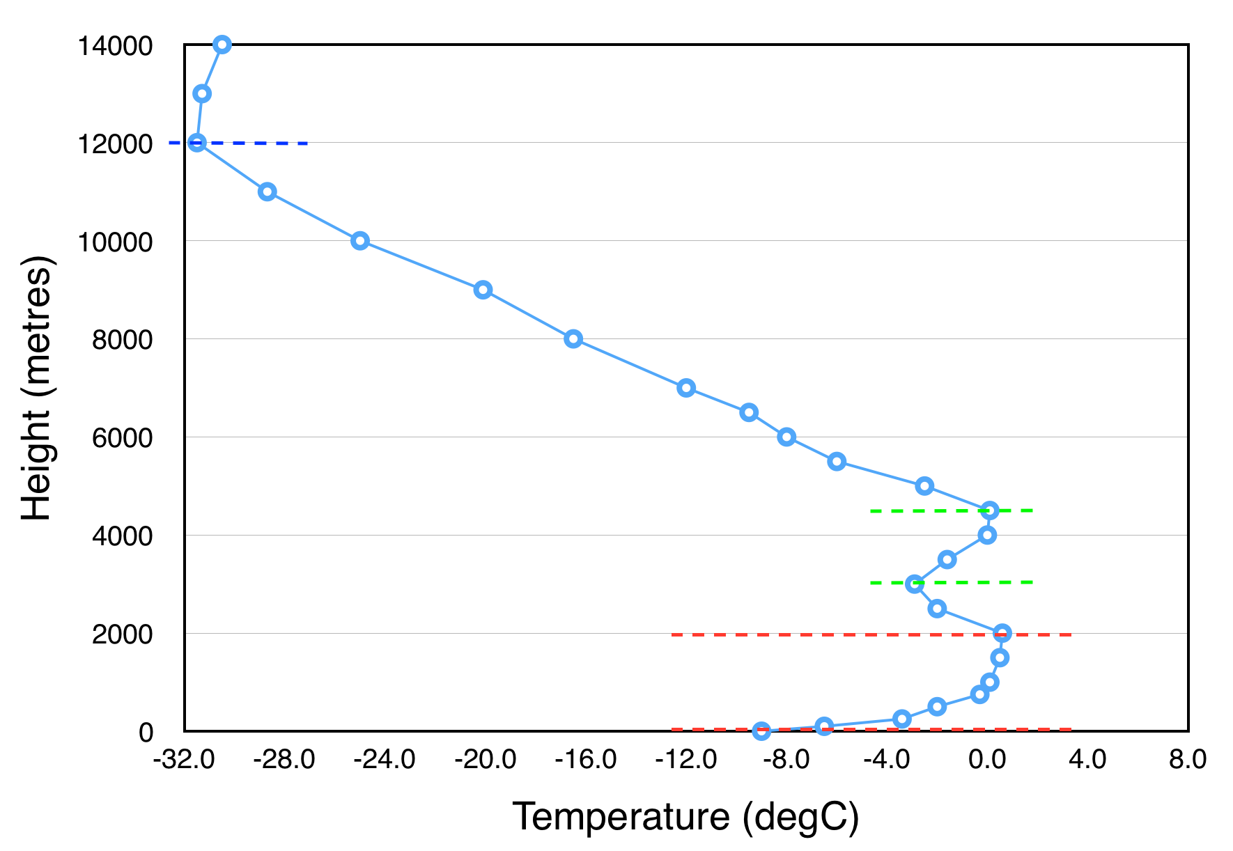
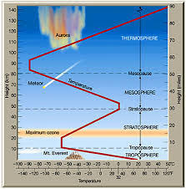
Lab 2: Atmospheric Basics
Plotting a temperature profile and indicating inversions in the profile. Temperature inversions occur when temperature is increasing with increasing height (or decreasing pressure)

Slide 6
Data set for lab
All of the labs have some modification from the initial manual instructions (Always refer to the extra directions)
First start by plotting every point and then you can plot less meticulously.
Pay close attention to where temperature in increasing or staying roughly constant

